Slide 1
Number Systems, Operations & Codes
CME 2003
Digital Logic
Şerife YILMAZ

Slide 2
OUTLINE
Decimal Numbers
Binary Numbers
Decimal-to-Binary Conversion
Binary Arithmetic
1's and 2's Complements of Binary Numbers
Signed Numbers
Arithmetic Operations with Signed Numbers
Hexadecimal Numbers
Octal Numbers
Binary Coded Decimal (BCD)
Digital Codes
Error Detection and Correction Codes

Slide 3
DECIMAL NUMBERS
The digit 5 has a weight of 10 in this position.
The digit 4 has a weight of 1 in this position.
5 4
5 x 10 + 4 x 1
50 + 4
54
weight

Slide 4
…DECIMAL NUMBERS
Powers of tens
… 10³ 10² 10^{1 .} 10⁻¹ 10⁻² 10⁻³ …
Decimal point
Example:
568.23 = (5 X 10 ² ) + (6 X 10 ¹) + (8 X 10 ⁰) + (2 X 10 ⁻¹ ) + (3 X 10 ⁻² )
= (5 X 100) + (6 X 10) + (8 X 1) + (2 X 0.1) + (3 X 0.01)
= 500 + 60 + 8 + 0.2 + 0.03

Slide 5
BINARY NUMBERS
Decimal Number | Binary Number |  | Decimal Number | Binary Number
0 | 0000 |  | 8 | 1000
1 | 0001 |  | 9 | 1001
2 | 0010 |  | 10 | 1010
3 | 0011 |  | 11 | 1011
4 | 0100 |  | 12 | 1100
5 | 0101 |  | 13 | 1101
6 | 0110 |  | 14 | 1110
7 | 0111 |  | 15 | 1111

Slide 6
Counting in Binary
with n bits you can count up to a number equal to 2^{n} - 1.
Largest decimal number = 2^{n} - 1
Example:
n=4
lagest decimal number : 2⁴ – 1 = 15

Slide 7
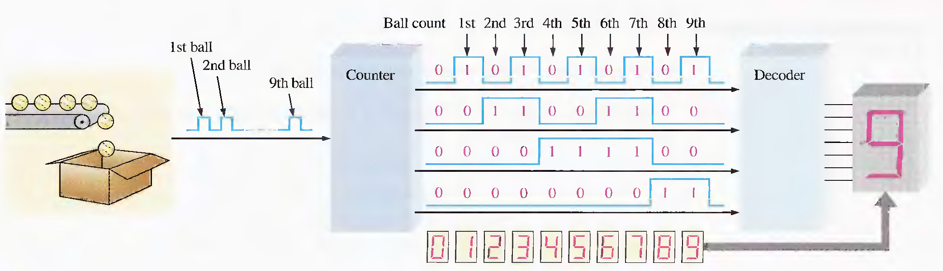
a simple binary counting application

Slide 8
The Weighting Structure of Binary Numbers
2^{n - I}. . . 2³ 2² 2¹ 2⁰ . 2⁻¹ 2⁻² . . . 2^{-n}
Binary point
LSB (least significant bit): The right-most bit
MSB (most significant bit): The left-most bit
MSB
LSB

Slide 9
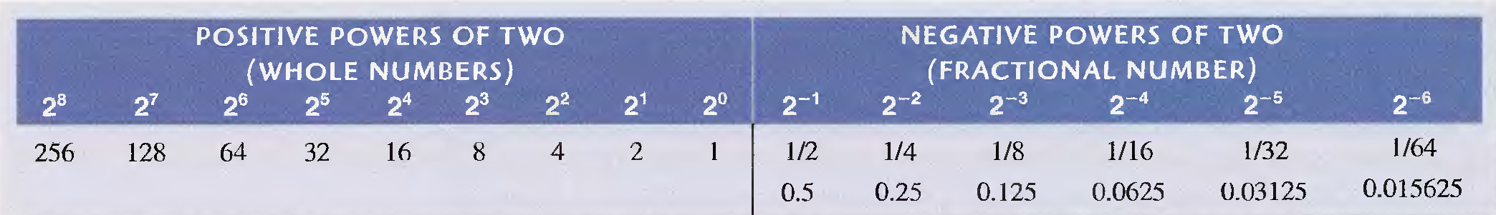
Binary weights

Slide 10
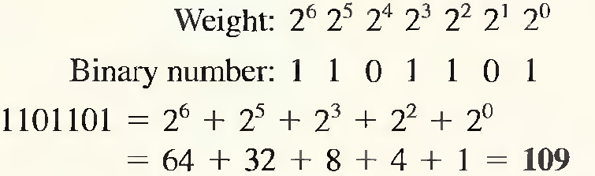
Binary-to-Decimal Conversion
The decimal value of any binary number can be found by adding the weights of all bits that are 1 and discarding the weights of all bits that are 0s.
EXAMPLE
Convert the binary whole number 1101101 to decimal.

Slide 11
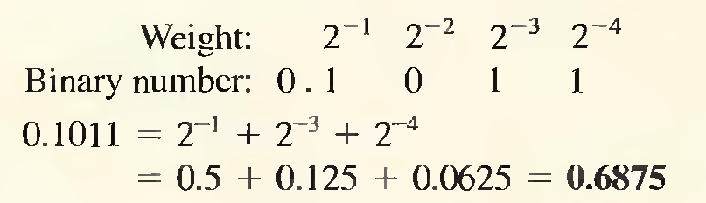
… Binary-to-Decimal Conversion
EXAMPLE
Convert the binary whole number 0.1011 to decimal.

Slide 12
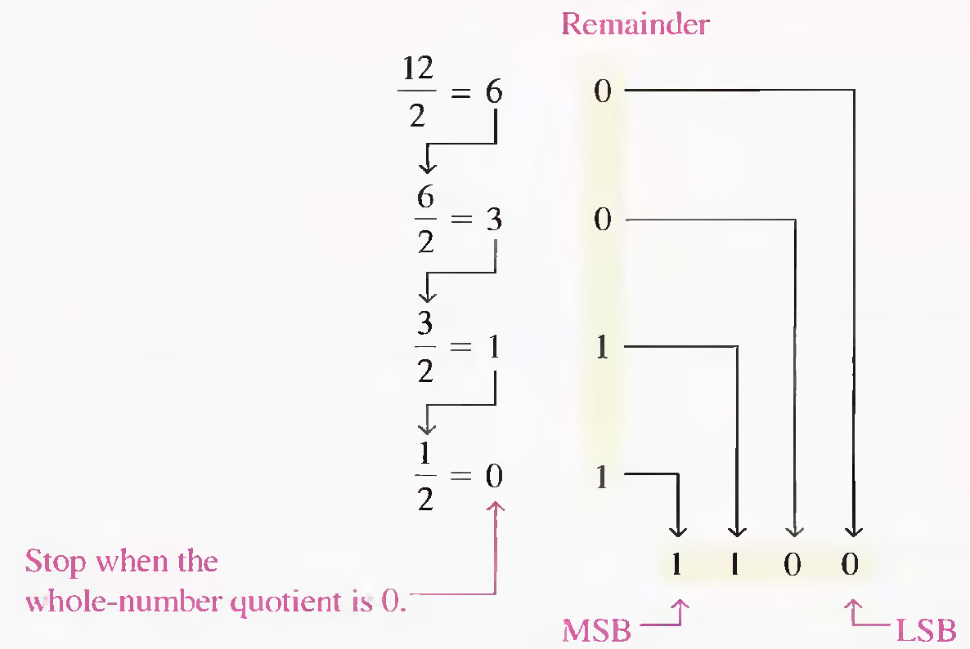
Decimal -To- Binary Conversion
Repeated Division-by-2 Method

Slide 13
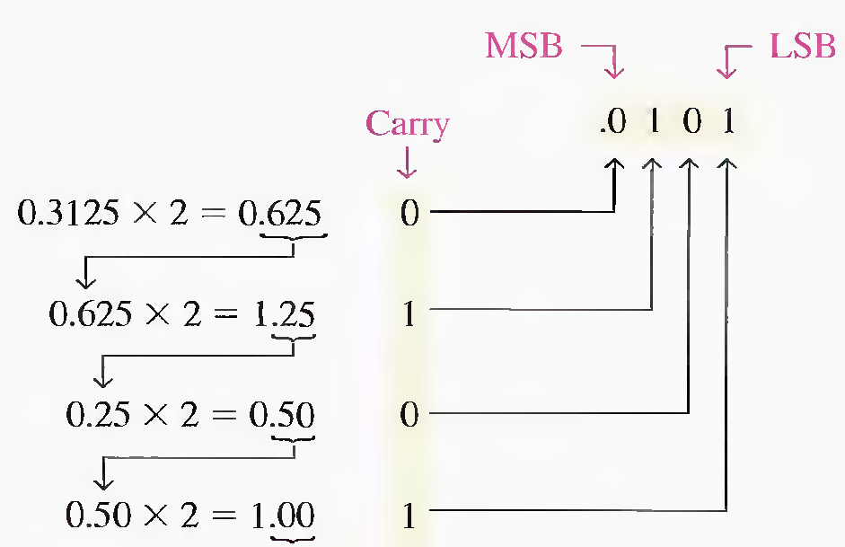
Converting Decimal Fractions to Binary
Repeated Multiplication by 2
Continue to the desired number of decimal places
or stop when the fractional part is all zeros.

Slide 14
BINARY ARITHMETIC
binary addition
subtraction
multiplication
division.

Slide 15
Binary Addition
0 + 0 = 0 Sum of 0 with a carry of 0
0 + 1 = 1 Sum of 1 with a carry of 0
1 + 0 = 1 Sum of 1 with a carry of 0
1 + 1 =10 Sum of 0 with a carry of 1

Slide 16
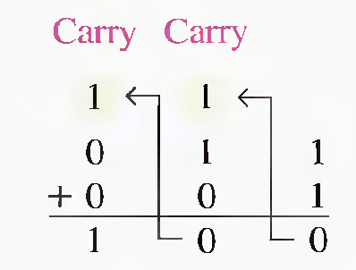
Binary Addition
1 + 0 + 0 = 01 Sum of 1 with a carry of 0
1 + 0 + 1 = 10 Sum of 0 with a carry of 1
1 + 1 + 0 = 10 Sum of 0 with a carry of 1
1 + 1 + 1 = 11 Sum of 0 with a carry of 1
carry

Slide 17
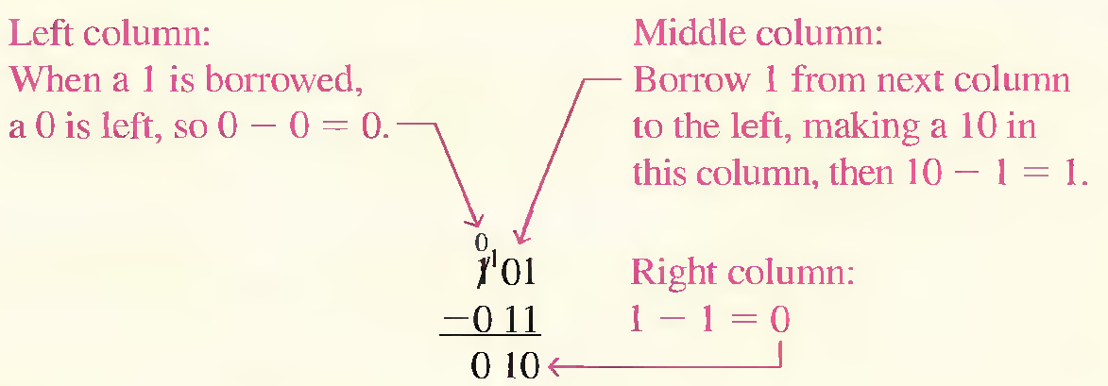
Binary Subtraction
0 – 0 = 0
1 – 1 = 0
1 – 0 = 1
10 - 1 = 1 (0 - 1 with a borrow of 1)

Slide 18
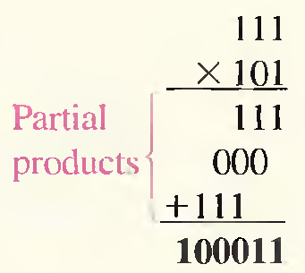
Binary Multiplication
0 x 0 = 0
0 x 1 = 0
1 x 0 = 0
1 x 1 = 1
Example

Slide 19
Binary Division
Division in binary follows the same procedure as division in decimal.
  Example:
  Perform the following binary division: 110 / 10 = ?
  110 10
  10 11
  010
  10
  00

Slide 20
Finding the 1's Complement
The 1's complement of a binary number is found by changing all 1s to 0s and all 0s to 1s,
Example
1 0 1 1 0 0 1 0 Binary number
0 1 0 0 1 1 0 1 1 's complement

Slide 21
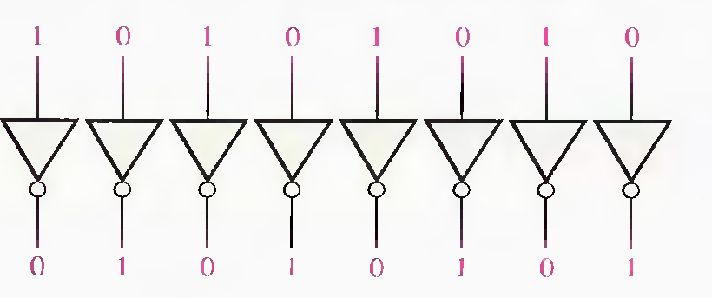
… Finding the 1's Complement
The simplest way to obtain the 1's complement of a binary number with a digital circuit is to use parallel inverters (NOT circuits).

Slide 22
Finding the 2's Complement
The 2's complement of a binary number is found by adding 1 to the LSB of the 1's complement.
2's complement = (1's complement) + 1
Example
1 0 1 1 0 0 1 0 Binary number
0 1 0 0 1 1 0 1 1 's complement
+ 1 Add 1
0 1 0 0 1 1 1 0 2 's complement

Slide 23

An alternative method of finding the 2's complement of a binary number
Start at the right with the LSB and write the bits as they are up to and including the first 1.
Take the 1's complements of the remaining bits.

Slide 24
Example
Find the 2's complement of 10111000 using the alternative method.
10111000
01001000
1's complements
of original bits
These bits stay the same

Slide 25
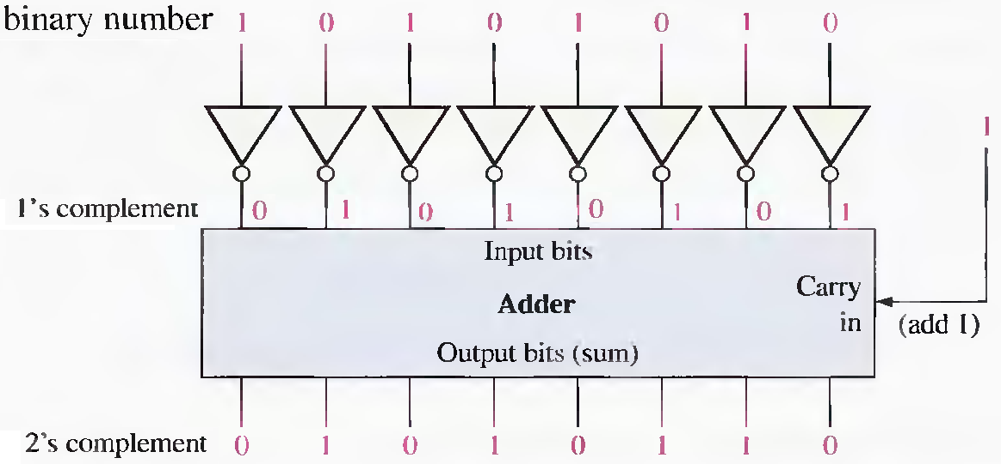
Example

Slide 26
SIGNED NUMBERS
A signed binary number consists of both sign and magnitude information.
The sign indicates whether a number is positive or negative, and the magnitude is the value of the number.
  sign-magnitude
  1's complement
  2’s complement.

Slide 27
The Sign Bit
The left-most bit in a signed binary number is the sign bit, which tells you whether the number is positive or negative:
    0 ➢ a positive number
    1 ➢ a negative number.

Slide 28
Sign-Magnitude Form
a negative number has the same magnitude bits as the corresponding positive number but the sign bit is a 1 rather than a zero.
Example
+ 25 : 0 0 0 1 1 0 0 1
Sign bit
Magnitude bits
- 25 : 1 0 0 1 1 0 0 1

Slide 29
1' s Complement Form
a negative number is the 1's complement of the corresponding positive number.
Example
+ 25 : 0 0 0 1 1 0 0 1
Sign bit
1's complement
- 25 : 1 1 1 0 0 1 1 0

Slide 30
2' s Complement Form
a negative number is the 2's complement of the corresponding positive number.
Example
+ 25 : 0 0 0 1 1 0 0 1
Sign bit
2's complement
- 25 : 1 1 1 0 0 1 1 1

Slide 31
The Decimal Value of Signed Numbers
Example:
Determine the decimal value of this signed binary number expressed in sign-magnitude: 10010101.
solution
The seven magnitude bits and their powers-of-two weights:
Sign bit 2⁶ 2⁵ 2⁴ 2³ 2² 2¹ 2⁰
1 0 0 1 0 1 0 1
Summing the weights where there are 1s,
16 + 4 + I = 21
The sign bit is 1; therefore, the decimal number is - 21.

Slide 32
Example:
Determine the decimal values of the signed binary numbers expressed in 1's complement:
  00010111
  11101000

Slide 33
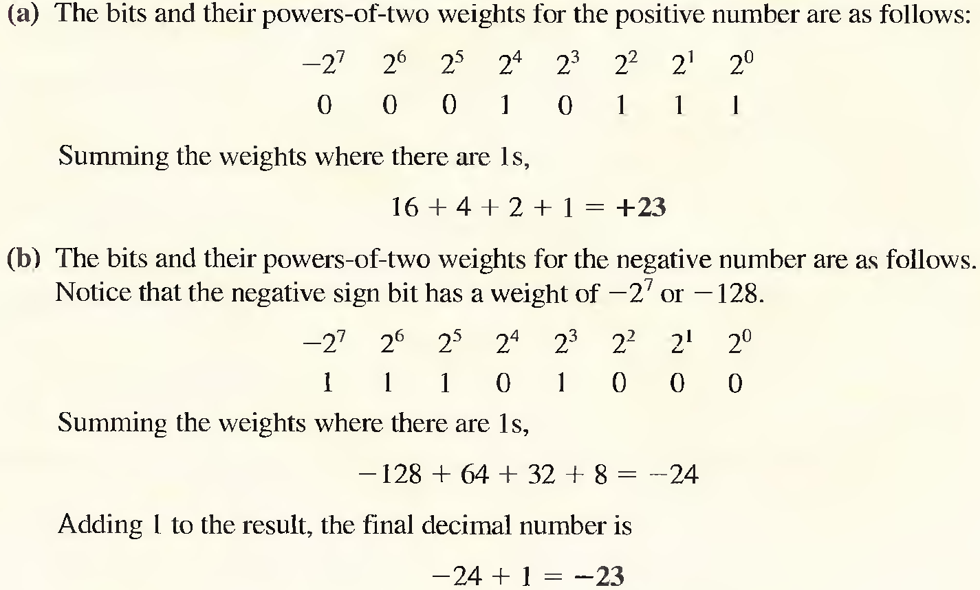
Solution

Slide 34
Example:
Determine the decimal values of the signed binary numbers expressed in 2's complement:
  01010110
  10101010

Slide 35
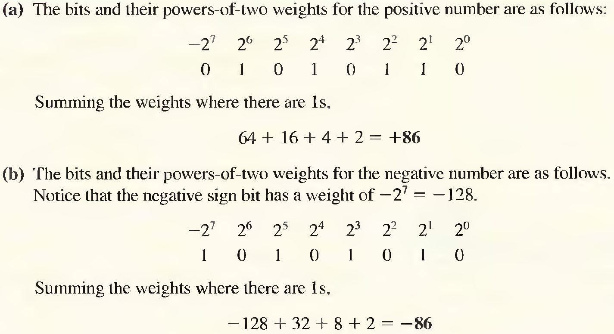
Solution

Slide 36
Range of Signed Integer Numbers
For 2's complement signed numbers, the range of values for n-bit numbers
(2^{n - 1}) to +(2^{n - 1} - 1)
Example:
n:8 => range = - ( 2⁷) to +( 2 ⁷ – 1)
- 128 to +127

Slide 37
Floating-Point Numbers
capable of representing very large and very small numbers without an increase in the number of bits
for representing numbers that have both integer and fractional components.
known as a real number
consists of two parts plus a sign:
  mantissa : magnitude of the number.
  exponent : number of places that the decimal point (or binary point) is to be moved.

Slide 38
… Floating-Point Numbers
Example : 241,506,800
    mantissa : 0.2415068
    exponent : 9
  0.2415068 x 10 ⁹

Slide 39
ANSI/IEEE Standard 754-1985
single-precision (32 bits)
double-precision (64 bits)
extended-precision. (80 bits)

Slide 40
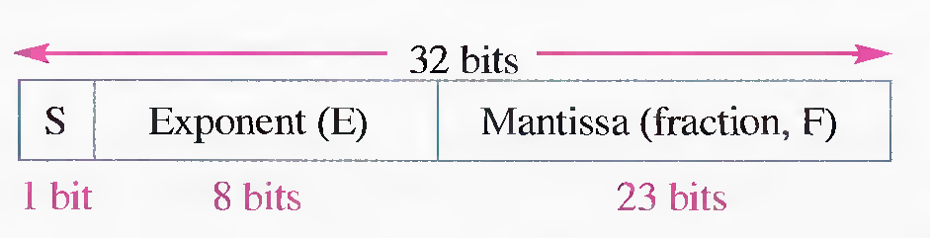

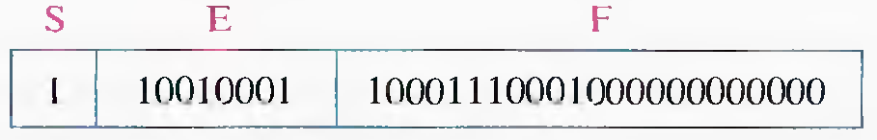
Single-Precision Floating-Point

Slide 41
Example: Single-Precision Floating-Point
Exponent: 10010001 = 145
Number = (-1) ¹ (1+0.10001110001)2⁽¹⁴⁵⁻¹²⁷⁾
= (-1) (1.1 0001110001)2 ⁽¹⁸ ⁾
= -1100011100010000000
This floating-point binary number is equivalent to
-407,688 in decimal.

Slide 42
Example: Single-Precision Floating-Point
Convert the decimal number 3.248 x 10 ⁴ to a single-precision floating-point binary number.
Solution:
Convert the decimal number to binary:
3.248 x 10 ⁴ = 32480 = 111111011100000 ₂
        = 1.11111011100000 X 2 ¹⁴
(the MSB will not occupy a bit position because it is always a 1)
Mantissa (23-bit binary): 11111011100000000000000
exponent : 14 + 127 = 141 = 10001101 ₂
The complete floating-point number is
0 | 10001101 | 11111011100000000000000

